Slide 1
Rockbuster Stealth LLC Sales Analysis for purposes of 2020 company strategy
Prepared by: Sanja Kesic

Slide 2
agenda
Introduction 3
Key Questions & Objectives 5
Summary 13
Recommendations 14
Back-up Slides 16

Slide 3

introduction
Rockbuster Stealth LLC is a movie rental company that used to have stores around the world. Facing stiff competition from streaming services such as Netflix and Amazon Prime, the Rockbuster Stealth management team is planning to use its existing movie licences to launch an online video rental service in order to stay competitive.
Objective: To help Rockbuster Stealth’s business intelligence (BI) department with the launch strategy for the new online video service.

Slide 4
Rockbuster Stealth LLC Data Overview:
1001 599 $2.98 108
Number of movies Number of customers Average Rental Cost Number of Countries
where are Customers
5 days Sport PG – 13 21
Average Rental Duration Most Popular Genre Most Popular Rating Number of Genres

Slide 5
Key Questions & Objectives

Slide 6
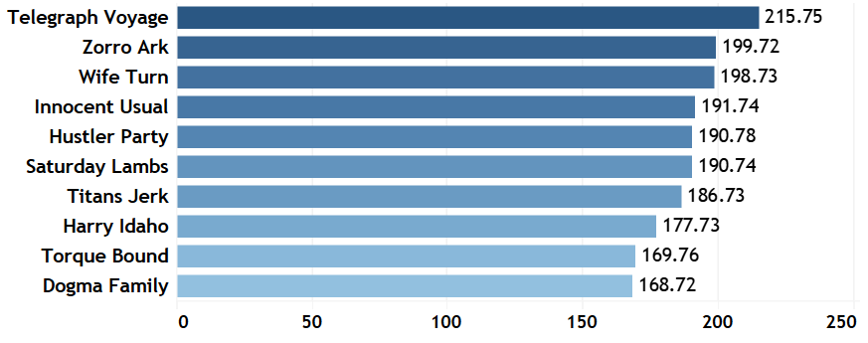
Which movies contributed the most to revenue gain?
Top 10 Movies that contributed the most to revenue gain
The Telegraph Voyage contributed the most to revenue with $215.75.
Title
Total revenue in $

Slide 7
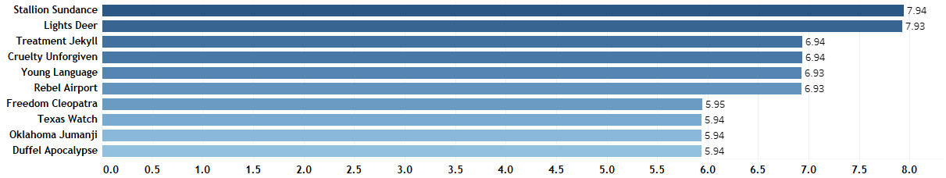
Which movies contributed the least to revenue gain?
Bottom 10 Movies that contributed the least to revenue gain
Title
The Duffel Apocalypse, Oklahoma Jumanji and Texas Watch contributed the least to revenue with $5.94 each.
Total revenue in $

Slide 8
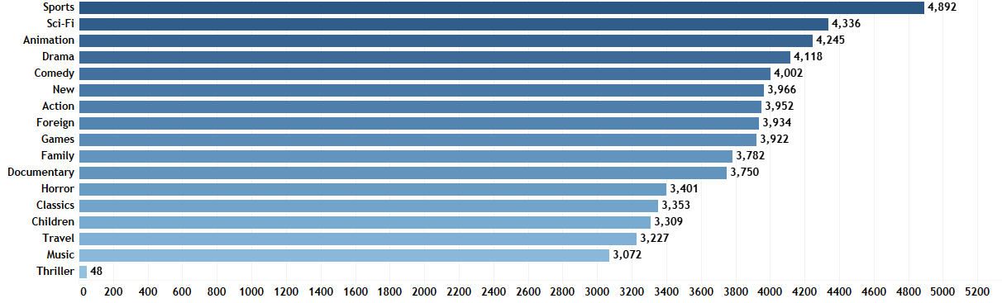
Which movie genres contributed the most to revenue gain?
Top 10 movie Genres that contributed the most to revenue gain
Genre
Top 5 Movie Genres:
Sports
Sci-fi
Animation
Drama
Comedy
Total revenue in $

Slide 9
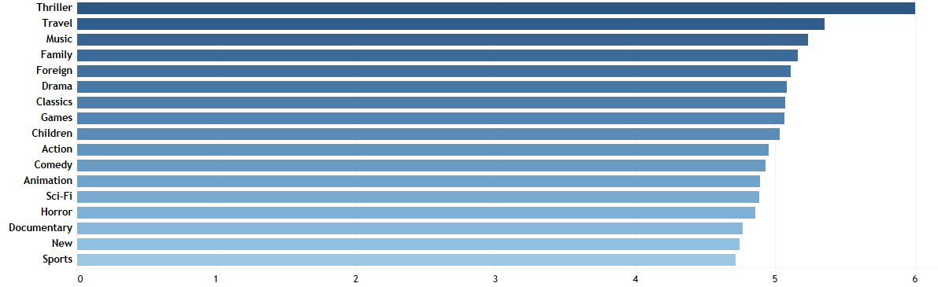
What was the average rental duration for all videos?
Average Rental Duration in Days per Genre
Title
The average rental duration over all genres is 4,991 days. Thriller is the genre with the highest rental duration of 6 days.
Days

Slide 10
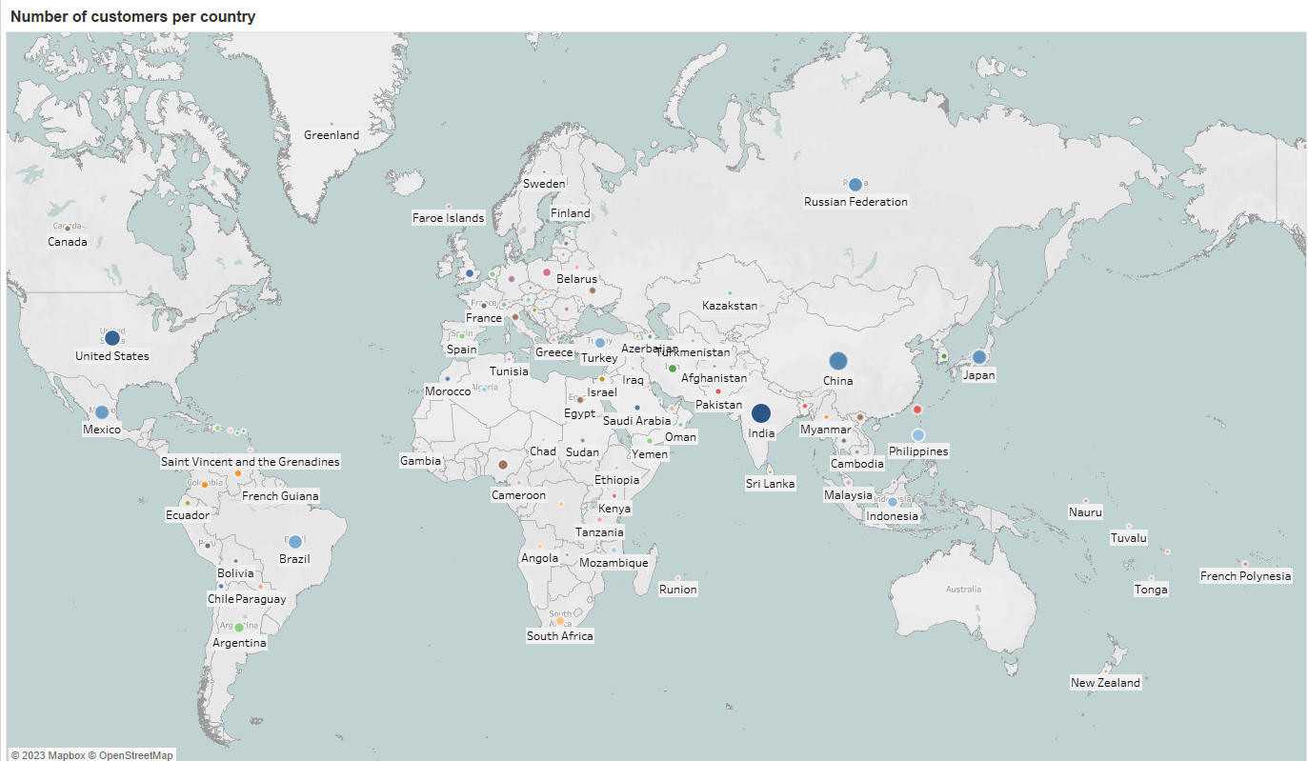
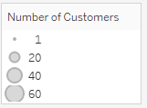
Which countries are Rockbuster customers based in?
A total of 599 customers are based in 108 countries.
Top 10 Countries with the most customers:
India 60
China 53
US 36
Japan 31
Mexico 30
Brazil 28
Russian Federation 28
Philippines 20
Turkey 15
Indonesia 14

Slide 11
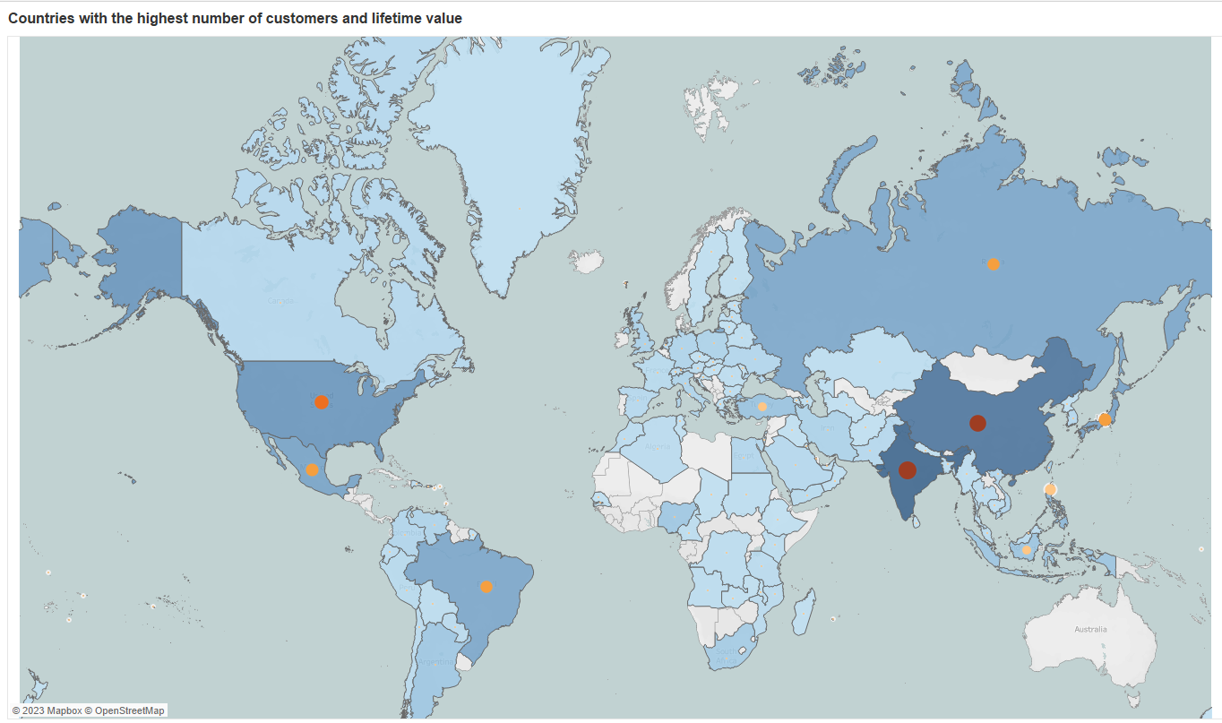
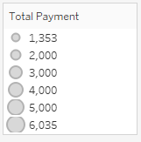
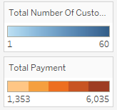
Where are customers with a high lifetime value based?
Top 10 Customers with a highest lifetime value are based in:
India $6,035
China $5,251
US $3,685
Japan $3,123
Mexico $2,985
Brazil $2,919
Russian Federation $2,766
Philippines $2,220
Turkey $1,498
Indonesia $1,353
These countries have also the highest customer counts.

Slide 12
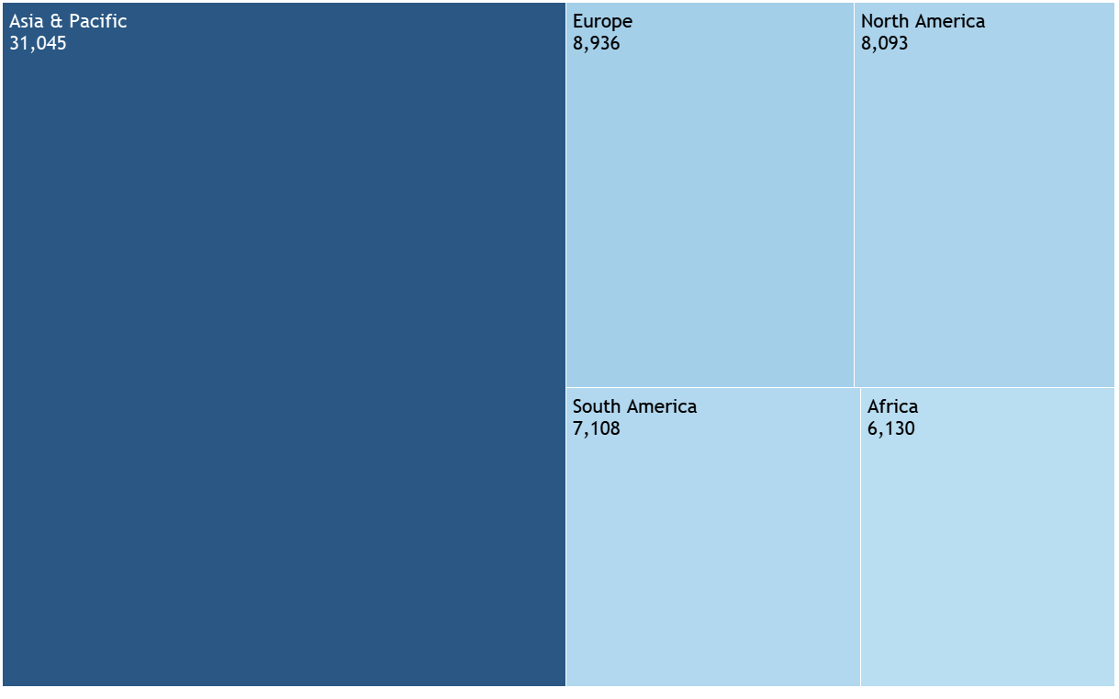
Do sales figure vary between geographic regions?
Revenue in $ by geographical region
Asia has by far the most revenue followed by Europe and North America.

Slide 13

summary
Top 5 Movies: Telegraph Voyage, Zorro Ark, Wife Turn, Innocent Usual, Hustler Party.
Top 5 movie Genres: Sports, Sci-fi, Animation, Drama, Comedy.
Average rental duration in days across genres is 5 days, while Thriller has the highest rental duration of 6 days.
A total of 599 customers are based in 108 countries. Top 5 countries with the most customers are India (60), China, US, Japan and Mexico(30).
Top 5 customers with a highest lifetime value are based in India ($6,035), China, US, Japan and Mexico($2,985).
The most profitable region is by far Asia followed by Europe and North America.

Slide 14
Recommendations
Rockbuster Stealth LLC can prioritize titles with higher demands and revenue and may consider removing low revenue movies.
Targeting market with high revenue genres such as Sport, Sci-fi, Animation, Drama and Comedy.
Adjusting prices for rental duration by giving lower price for shorter rental and bigger price for longer(more than 6 days) in order to encourage customers to rent more frequently.
Focus on marketing in Asia, the most profitable region, followed by Europe and North America.
Implement loyalty programs, for customers with a highest lifetime value, by offering them discounts on rentals, special subscription plans, every 10th movie with half price, special family packages, special offers if they bring a new customer.
Focus on offering a wider range of subtitles to be able to reach more customers across the globe.

Slide 15
thank you
If you have any more questions, please feel free to contact me!
Sanja Kesic
skesic@gmail.com
https://public.tableau.com/app/profile/sanja1971/viz/RockbusterStealthLLCSalesAnalysis/RockbusterStealthLLCSalesAnalysis?publish=yes

Slide 16
Back-up
slides

Slide 17
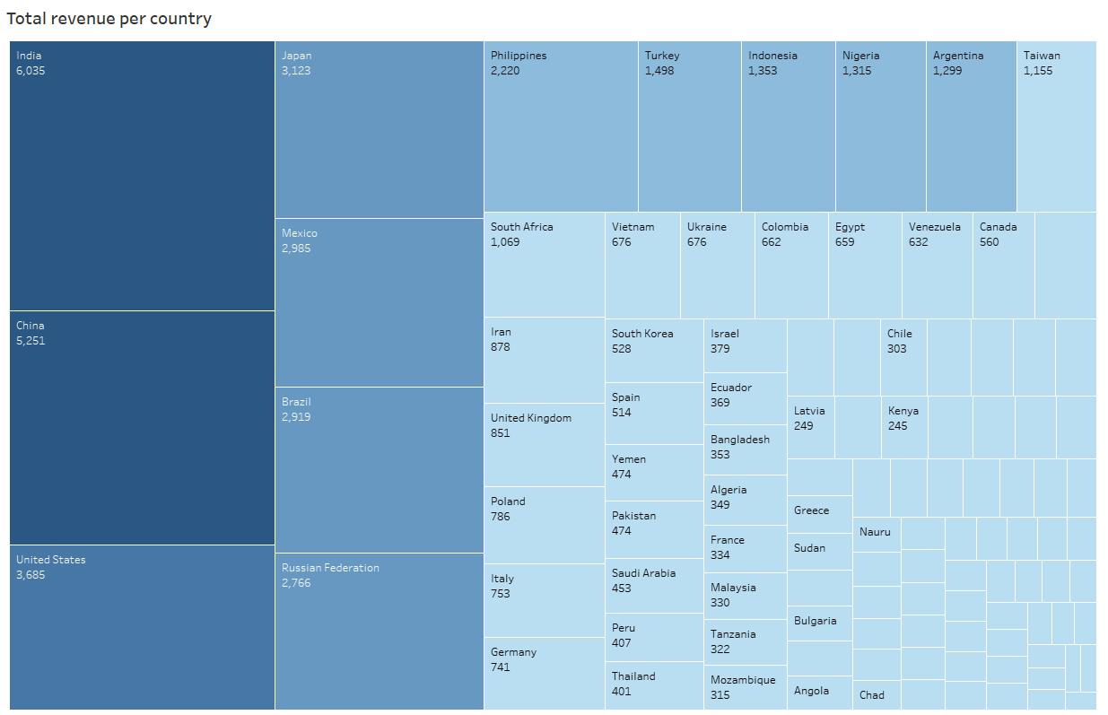
What is total Revenue per Country in $?

